Slide 1
Real Estate EDA Presentation
Company: Next Hikes IT Solutions
Project: Exploratory Data Analysis (EDA) for Real Estate Pricing
🙏

Slide 2
📌 Project Introduction
🔍 Objective: Unveil the key factors influencing real estate pricing in a dynamic market.
🔍 Tools Used: Python, Pandas, Matplotlib, Seaborn, Jupyter Notebook.
🔍 Company: Next Hikes IT Solutions

Slide 3
📊 Dataset Overview
The dataset used in this project comprises comprehensive housing information aimed at predicting real estate sale prices using various features. It includes 1,460 observations and 81 attributes.
Feature Categories
🔍 Property Characteristics: Lot area, frontage, shape, and zoning
🔍 Construction Details: Year built, quality, materials used
🔍 Interior Features: Living area, number of rooms, kitchens, bathrooms
🔍 Basement & Garage: Basement type/area, garage size and year
🔍 Amenities: Deck area, pool, fireplace, porches
Location Info: Neighborhood, street access, condition
Sale Conditions: Month/year sold, sale type, and condition

Slide 4
🔍 Step 3: Handling Missing Values
🔍 Used df.isnull().sum() to identify missing values.
🔍 Columns like 'Alley', 'MasVnrType', 'GarageYrBlt' had missing values.
🔍 Strategy: Removed or filled based on context (mean, mode, 0).

Slide 5
📈 Step 4: Descriptive Statistics
🔍 Used df.describe() to understand distribution of numerical features.
🔍 Identified min, max, mean, standard deviation for each column.

Slide 6
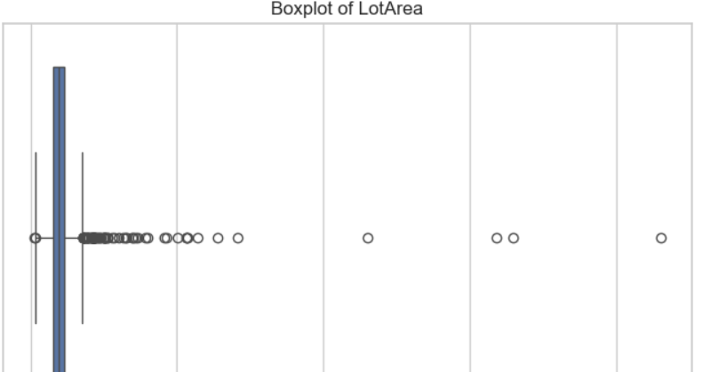
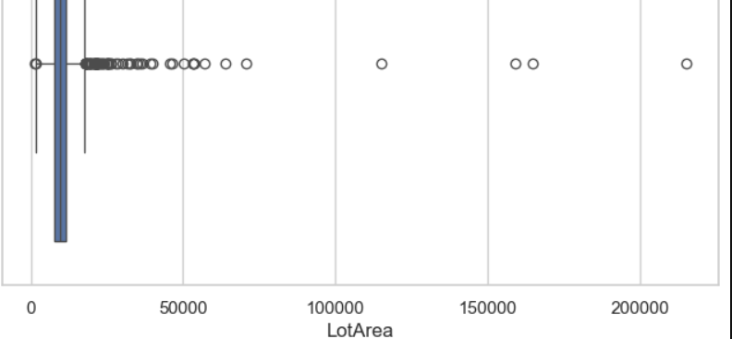
📊 Step 5: Data Visualization
🔍 Bar plots, Histograms, Boxplots, and Heatmaps were used.
🔍 Revealed data distribution, outliers, and correlation patterns.

Slide 7
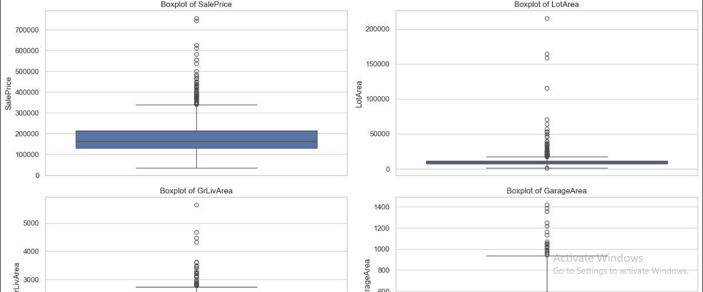
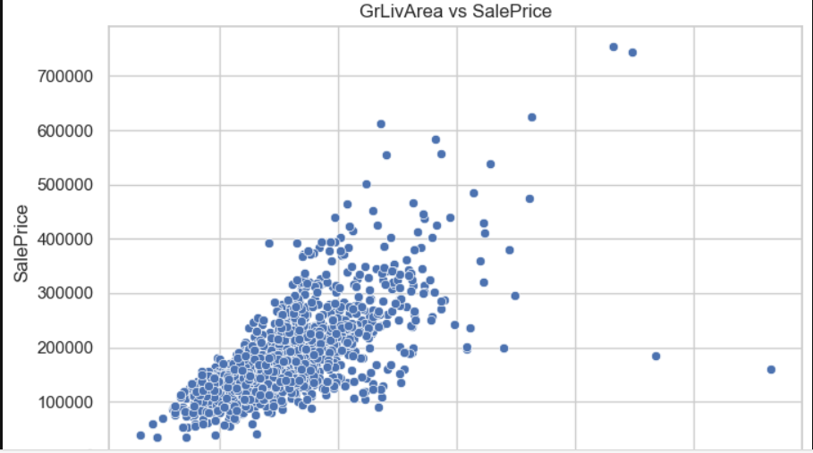
🚨 Step 6: Outlier Detection
🔍 Detected using boxplots on features like 'GrLivArea', 'LotArea'.
🔍 Outliers treated based on impact on target variable 'SalePrice'.

Slide 8
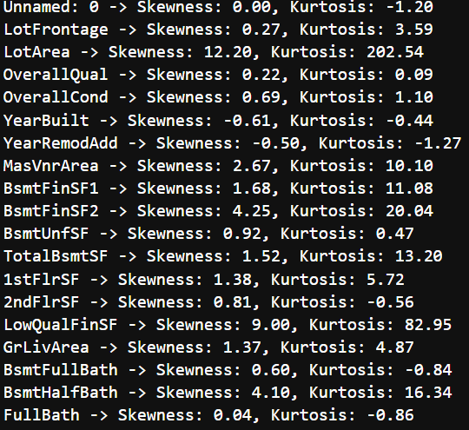
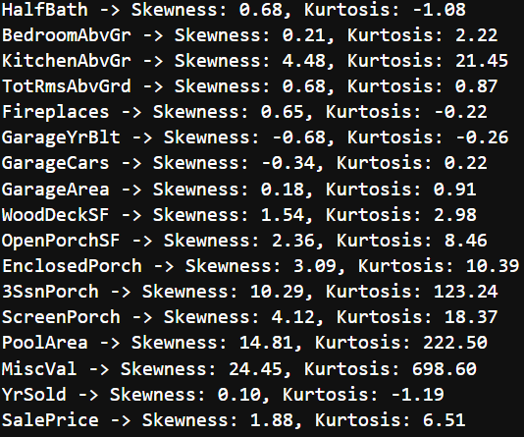
📉 Step 7: Skewness & Kurtosis
🔍 Calculated to understand the shape of data distribution.
🔍 Transformed highly skewed data using log or square root if needed.

Slide 9
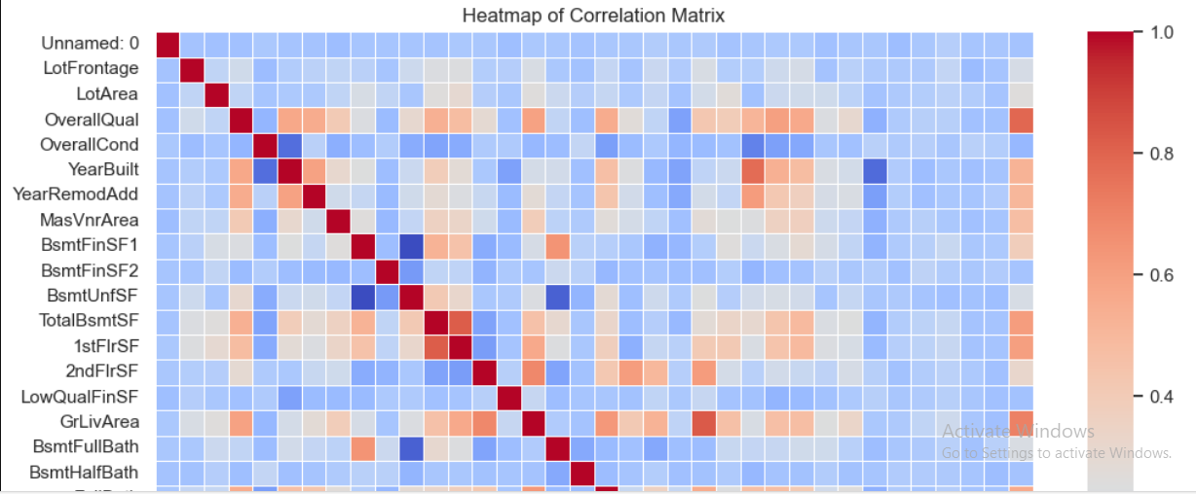
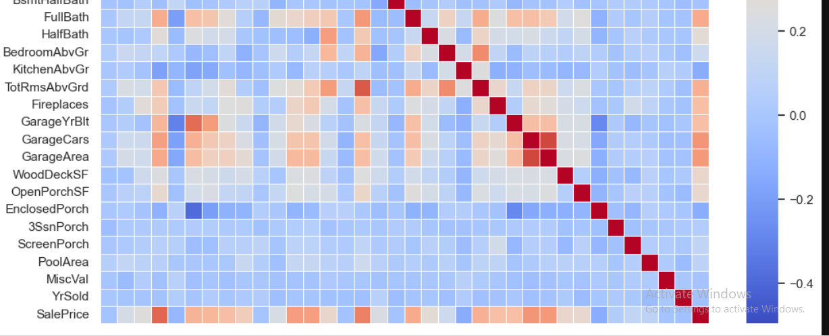
📌 Step 8: Correlation Matrix
🔍 Generated using df.corr() and visualized with seaborn heatmap.
🔍 Strong positive correlation found with 'OverallQual' and 'GrLivArea'.

Slide 10
✅ Conclusion
📌 This exploratory data analysis (EDA) project provided deep insights into the key factors influencing house prices in a dynamic real estate market.
📌 Through statistical summaries, visualizations like boxplots, histograms, and heatmaps, and correlation analysis, we identified strong relationships between variables such as OverallQual, GrLivArea, and TotalBsmtSF with the SalePrice.
📌 The process also involved handling missing values, detecting outliers, and understanding distribution patterns, setting a strong foundation for future machine learning modeling.
📌 This analysis equips stakeholders—buyers, sellers, and analysts—with data-driven insights for informed decision-making in property valuation.

Slide 11
🙏Acknowledgments
📌 I would like to express my heartfelt gratitude to Next Hikes IT Solutions for providing me the opportunity to work on this enriching project.
📌 Their platform, mentorship, and support have been instrumental in shaping this learning experience.
📌 This project helped me apply practical data science techniques and enhanced my understanding of real-world data analysis challenges.
With sincere appreciation, SIDDIQUI SABA

Slide 12


